Slide 1
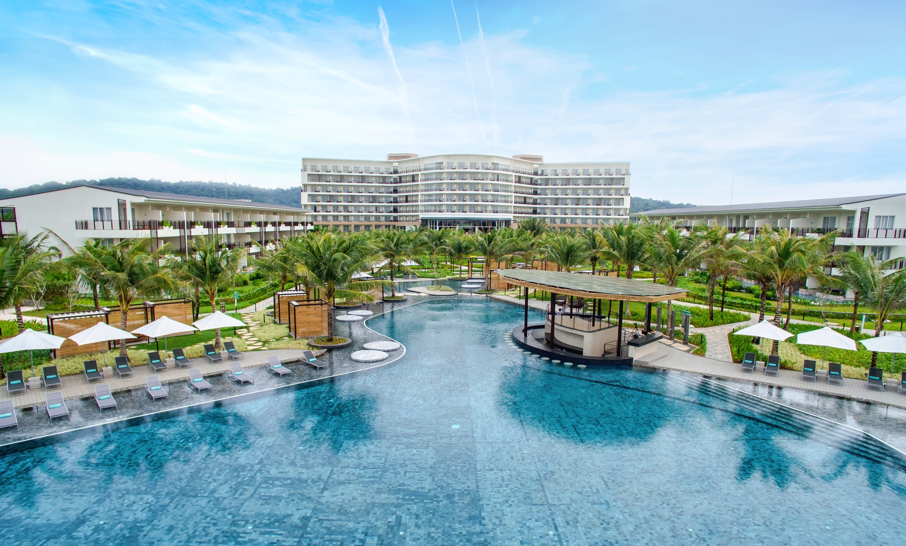

YOUR HOUSE ON THE BEACH
Homely And Fresh Décor Mediterranean Architecture Liberating Atmosphere
By Melia Hotels International

Slide 2


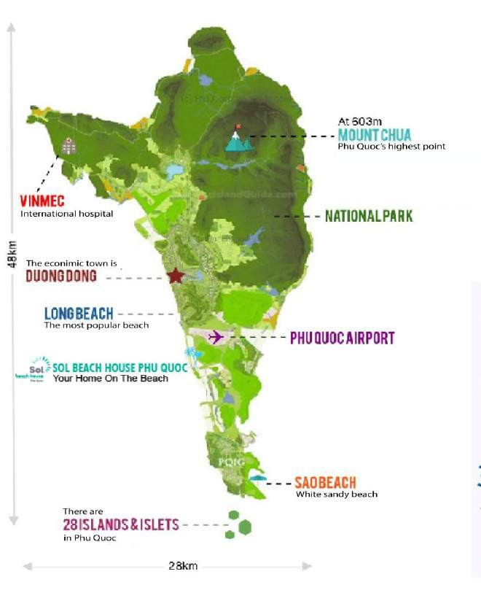


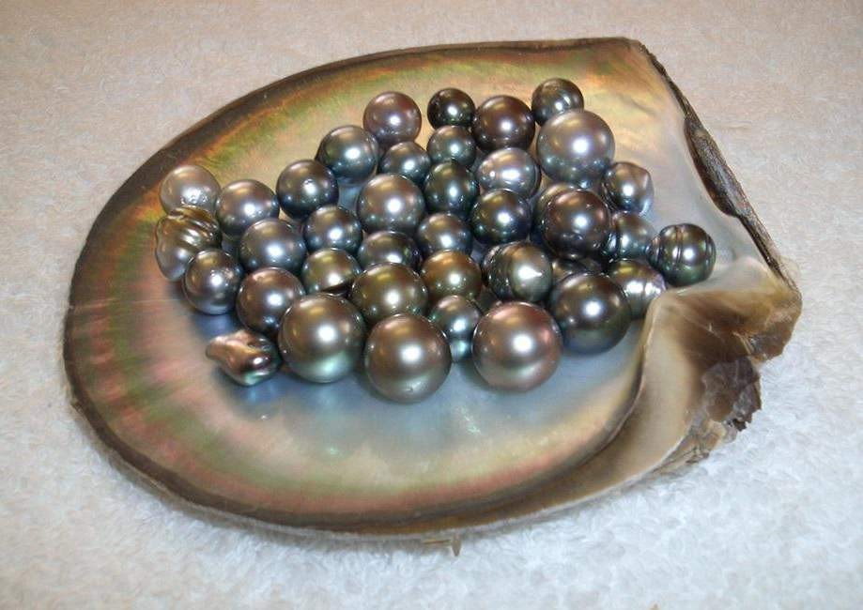
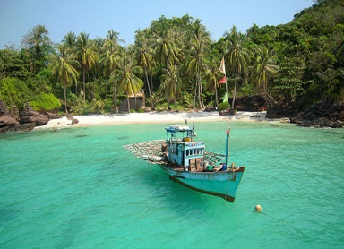
LARGEST ISLAND of Vietnam & in Gulf of Thailand.
EMERALD ISLAND with crystal clear turquoise water and fine sandy beach.
VINPEARL THEME PARK & SAFARI which is the largest safari in Vietnam.
HON THOM CABLE CAR - the longest cable car through the sea of the world (around 7,900m).
PHU QUOC NATION PARK - part of World Biosphere Reserve recognize by UNESCO.
DESTINATION
LOCATION
Pepper Farm
Natural Forest & Streams
PHU QUOC ISLAND MAP
Pearl products
Crystal Clear Water

Slide 3
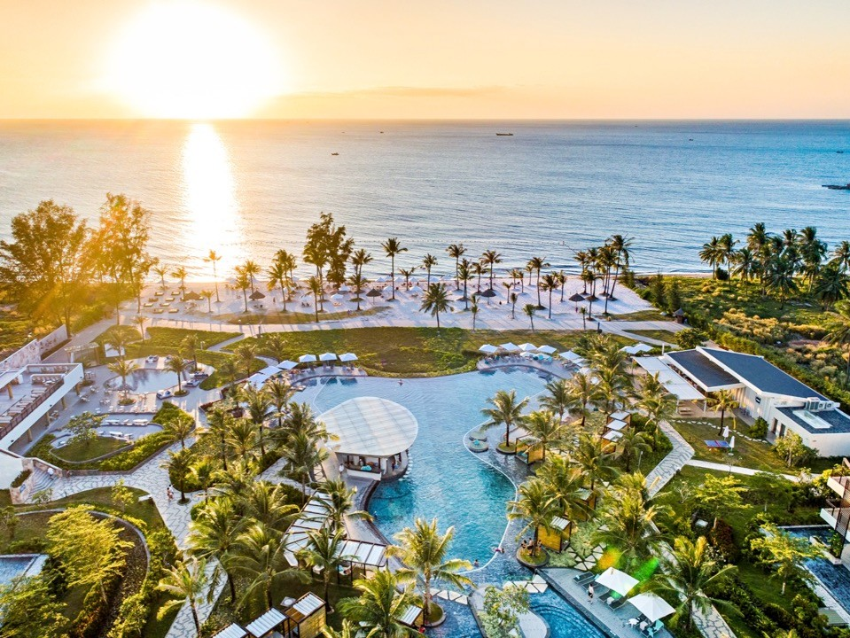
SOL BEACH HOUSE
Located on the beachfront and nestling in beautiful tropical gardens Sol Beach House Phu Quoc is naturally chic
and enchanting, helping you get immerse into the laid back mood of your holidays.

Slide 4

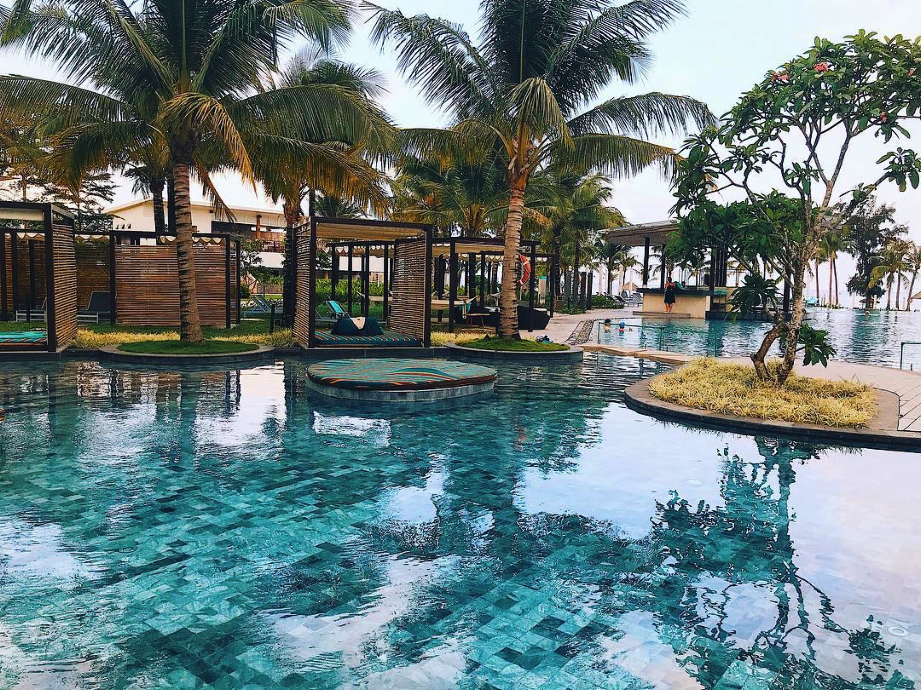
8 minutes from Phu Quoc International Airport
3 buildings with 284 rooms and suites
In-room experience: 5 room types, fully furnished and well equipped
F&B: 3 restaurants offering breakfast and board options
Wonderful infinity swimming pool overlooking to the sea
Chill out with white hammocks & Bali beds

Slide 5
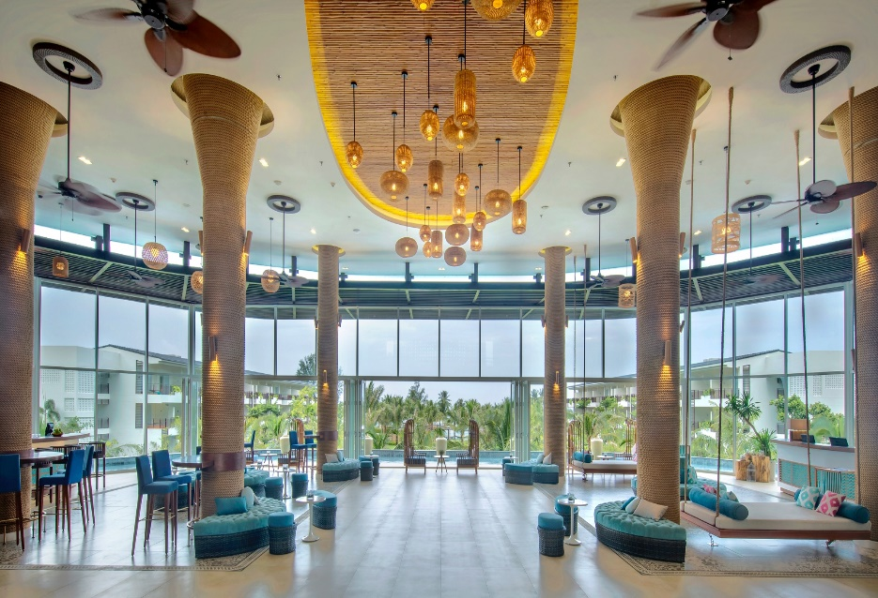
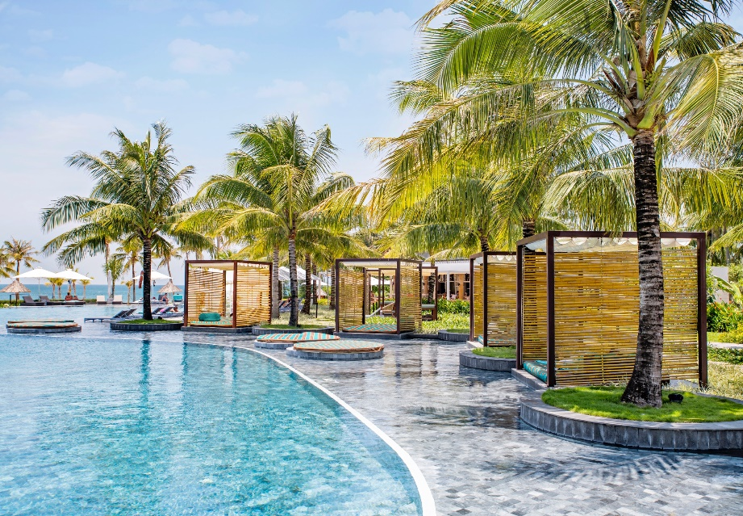
LOBBY
INFINITY SWIMMING POOL
Room Category | Type | Bathtub | Room Size | Units
Beach House Room | King/ Twin | No | 32.5 -34.4 m2 | 110
Big Beach House Room | King Twin | Yes | 45.8 - 54 m2 | 104
Xtra Beach House Room | King Twin | Yes | 55.3 - 54 m2 | 58
Xtra Beach House Junior Suite | King | Yes | 66.3 m2 | 10
Xtra Beach House Suite Room | King | Yes | 108 – 124 m2 | 2
ACCOMMODATION

Slide 6
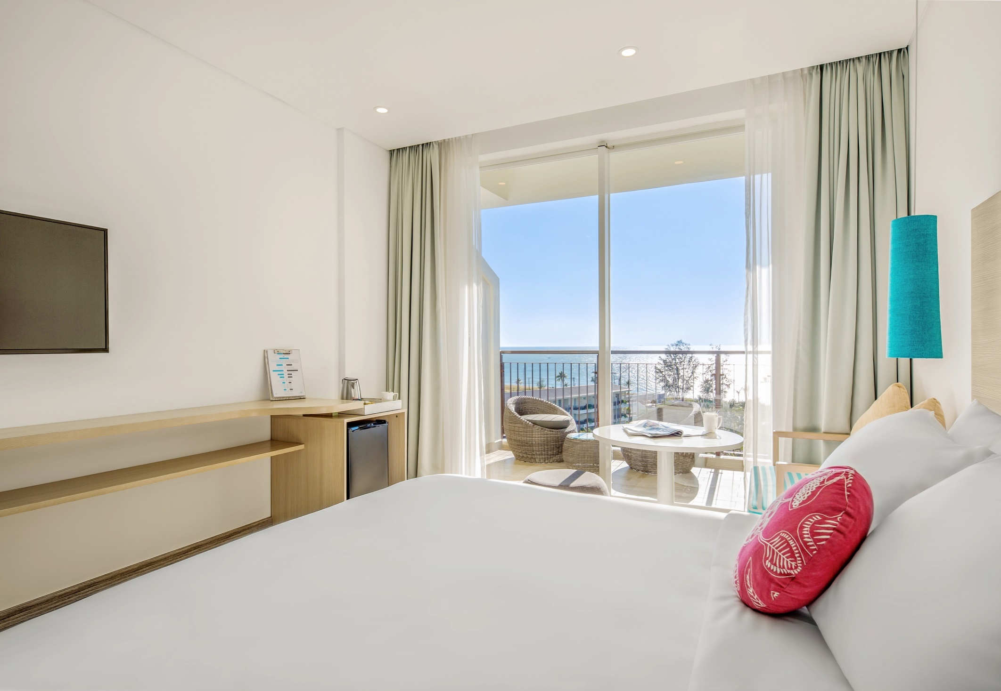
BEACH HOUSE ROOM
Location: Main Building
Room size: 33 - 35 m2
View: From Garden to the Sea

Slide 7
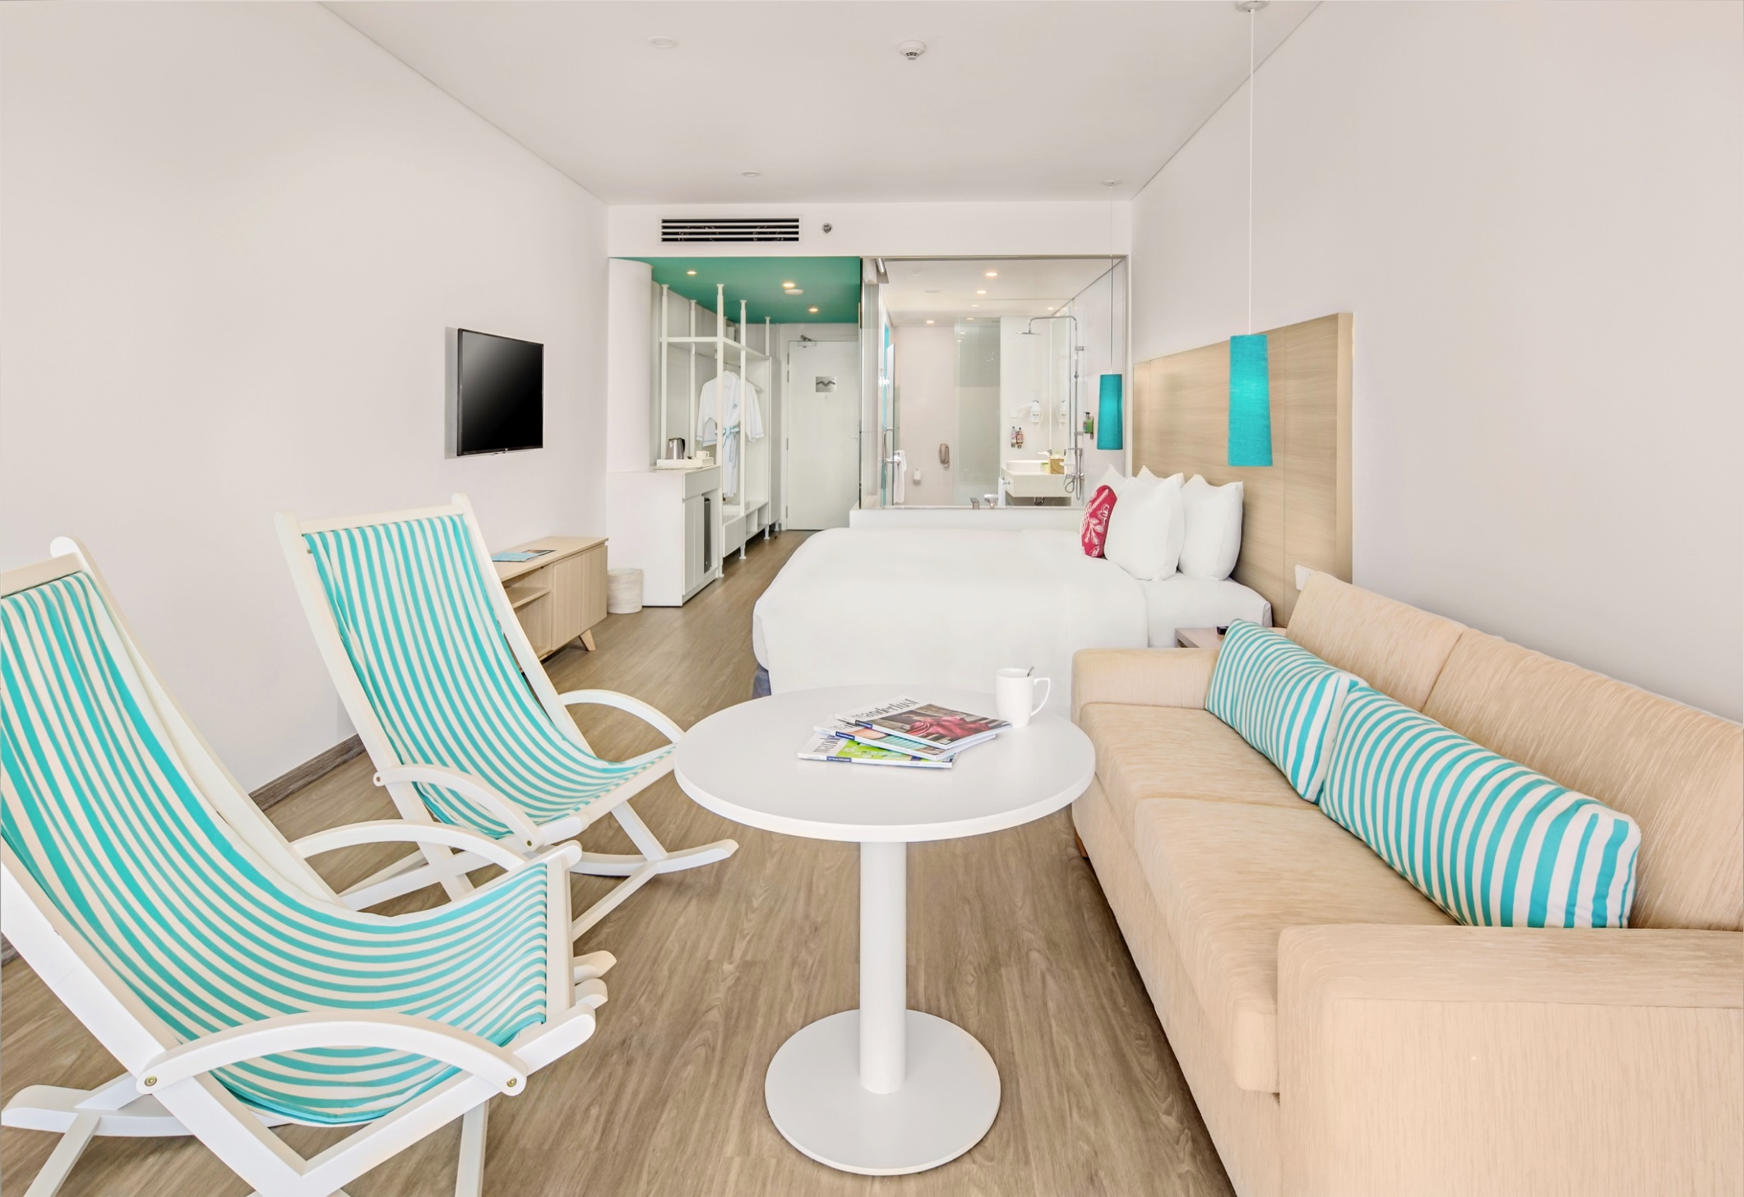
BIG BEACH HOUSE ROOM
Location: Main & Sun Building
Room size: 46 - 54 m2
View: From Garden to the Sea

Slide 8
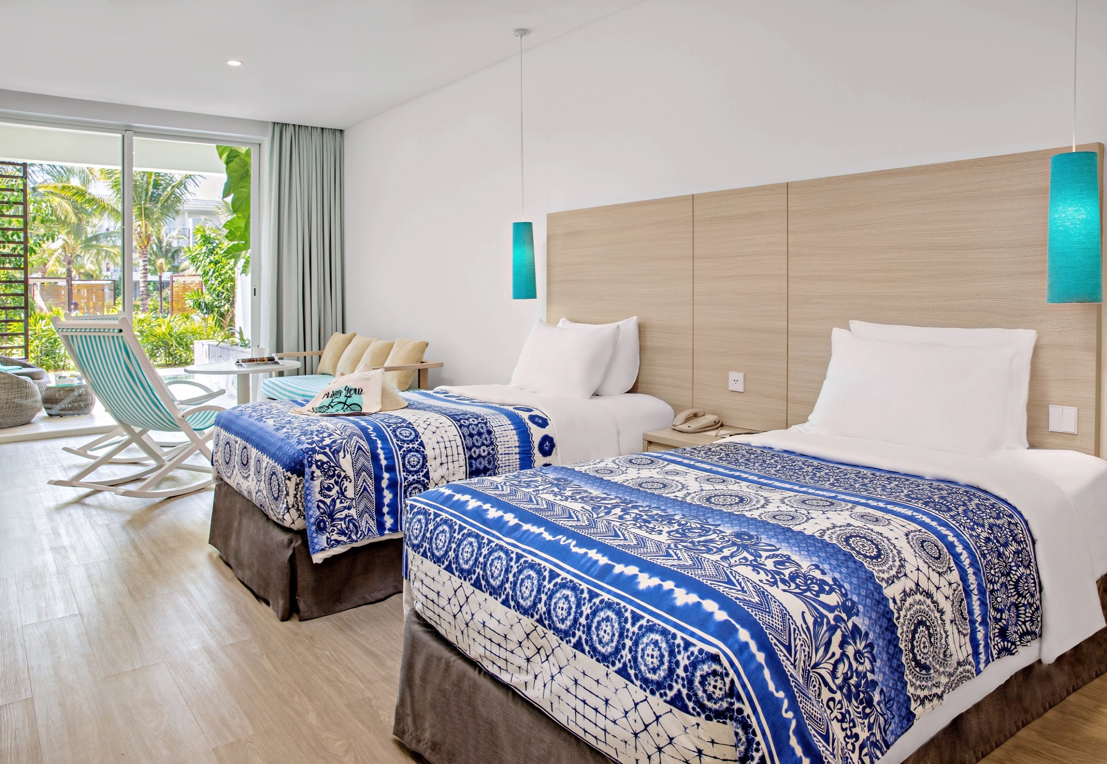
EXTRA BEACH HOUSE ROOM
Location: Main & Sea Building
Room size: 54 - 56 m2
View: From Garden to the Sea

Slide 9
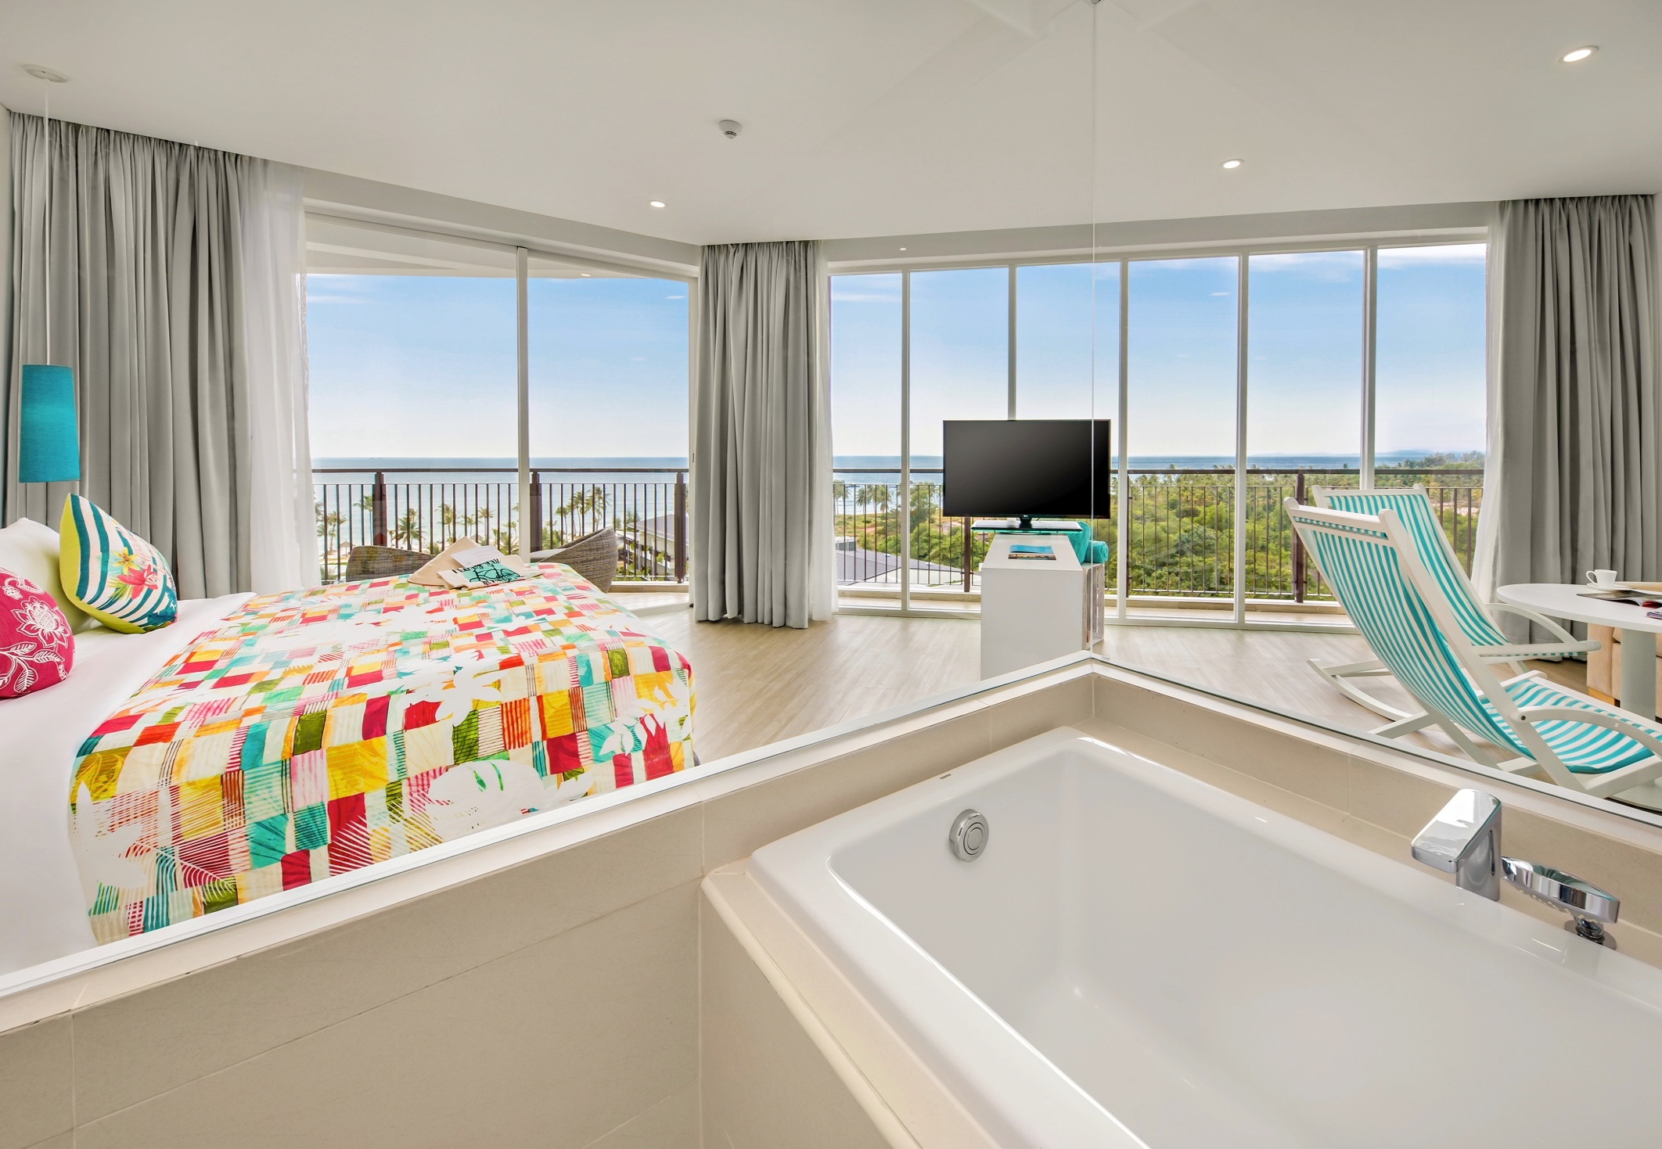
EXTRA BEACH HOUSE JUNIOR SUITE
Location: Main Building
Room size: 67 m2
View: From Garden to the Sea

Slide 10
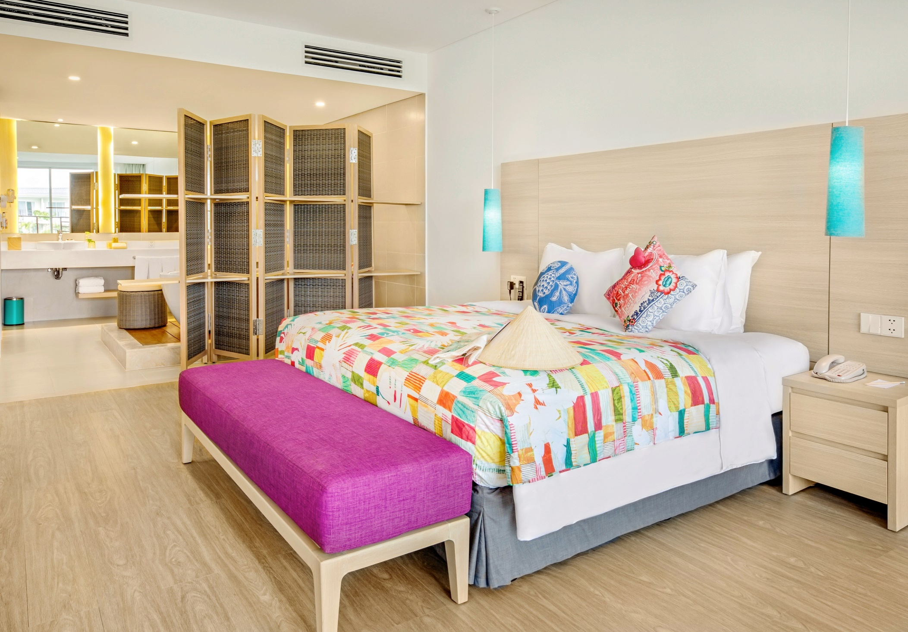
EXTRA BEACH HOUSE JUNIOR SUITE
Location: Sea Building
Room size: 108 - 124 m2
View: Garden & Sea

Slide 11
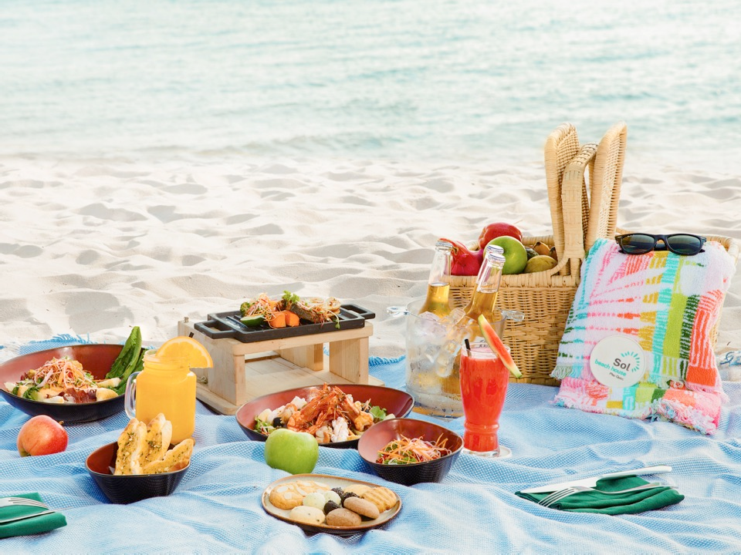
EXTRA BEACH HOUSE JUNIO SUITE
DINING EXPERIENCES
Location: Sea Building
Room size: 108 - 124 m2
View: Garden & Sea
Savour the best of Asian & International cuisine incorporates fresh local & International produce

Slide 12
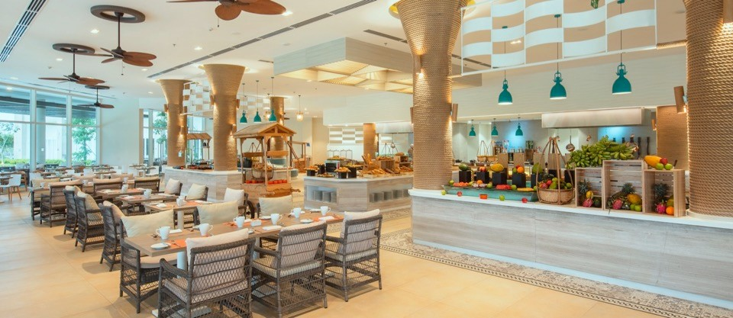
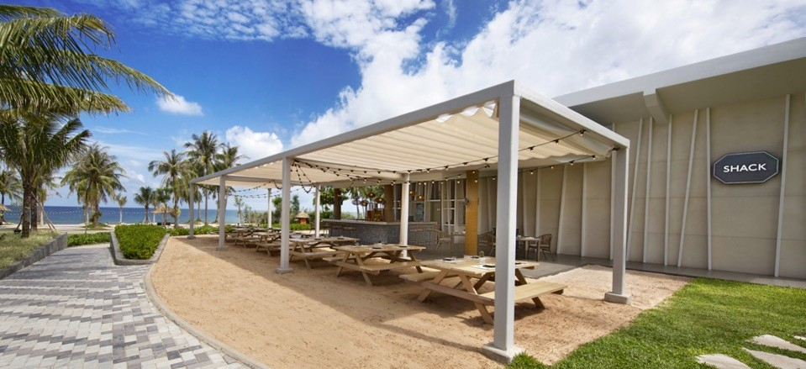
THE KITCHEN
All day dining restaurant served
Asian & International Cuisine
Buffet & A-la-Carte menu
Spacious indoor & terrace
Capacity: 266 seats
Location: Main Building
Operation Hour: 6:00 AM to 10:00 PM
THE SHACK
Menu: street food style, ice creams
& snacks
Brunch in your bikini: Easy & breezy
Relaxed, casual & friendly
Capacity: 73 seats
Location: Beachfront
Operation hours: 9:00AM to 6:30PM

Slide 13
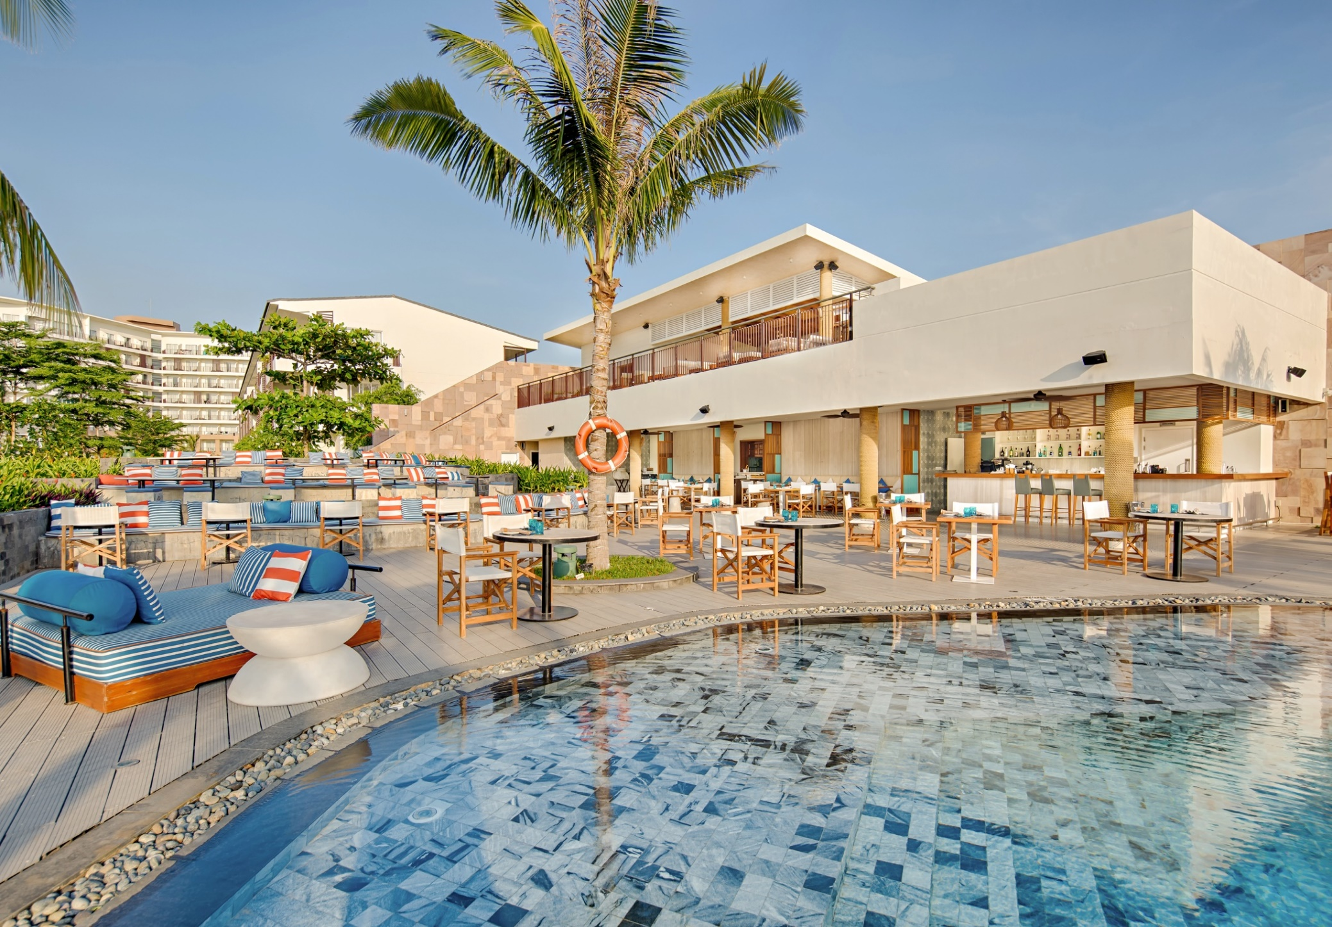
OLA BEACH CLUB
Seafood Mediterranean style
A private kid swimming pool
Outdoor seating & Rooftop sunset cocktail
DJ sunset sessions
Capacity: 160 seats
Location: Beachfront
Operation hours: 4:00PM till midnight

Slide 14
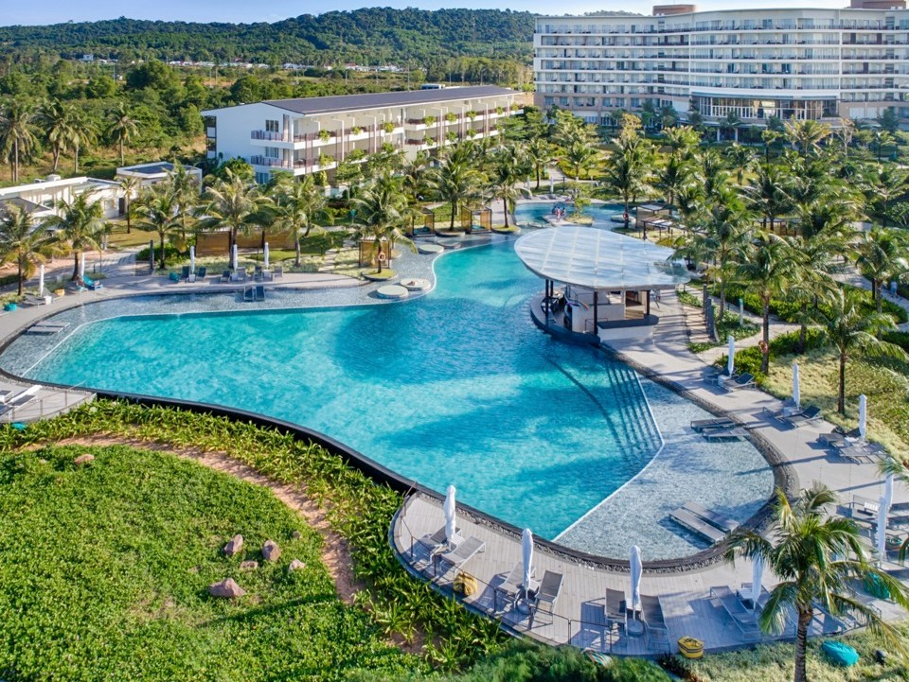
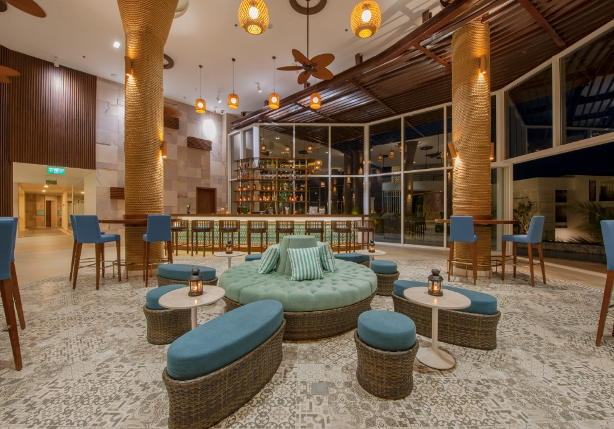
SWIMMING POOL BAR
Serving: Street food, Snack,
Beverages Relaxation
Capacity: 111 dry seats, 27 wet seats
Location: Main pool
Operation time: 9:00AM to 6:30PM
LOBBY BAR
Serving: Cocktail, Alcohol Drink,
Tea to chill with spectacular view
from Lobby to the sea
Location: Lobby
Operation time: 10:00AM to midnight

Slide 15
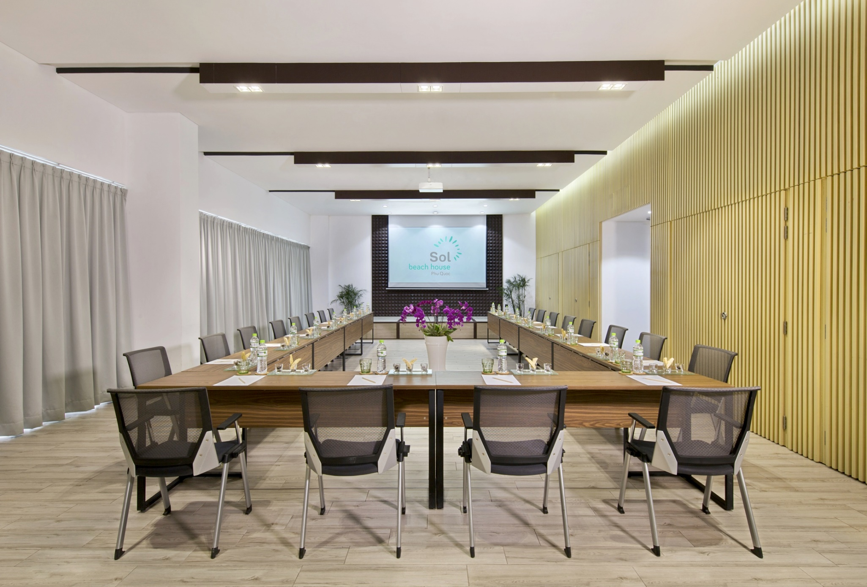
MEETING & EVENT
Fully furnished with stylish designs
Floor-to-ceiling glass doors allows best
natural daylight.
Modern audio visual equipment,
sumptuous food choices & beverages
- Area: 105m2
- Location: Main building
  Capacity
  • Theater: 100 - Classroom: 60 - Banquet: 50 - U-shape: 36

Slide 16
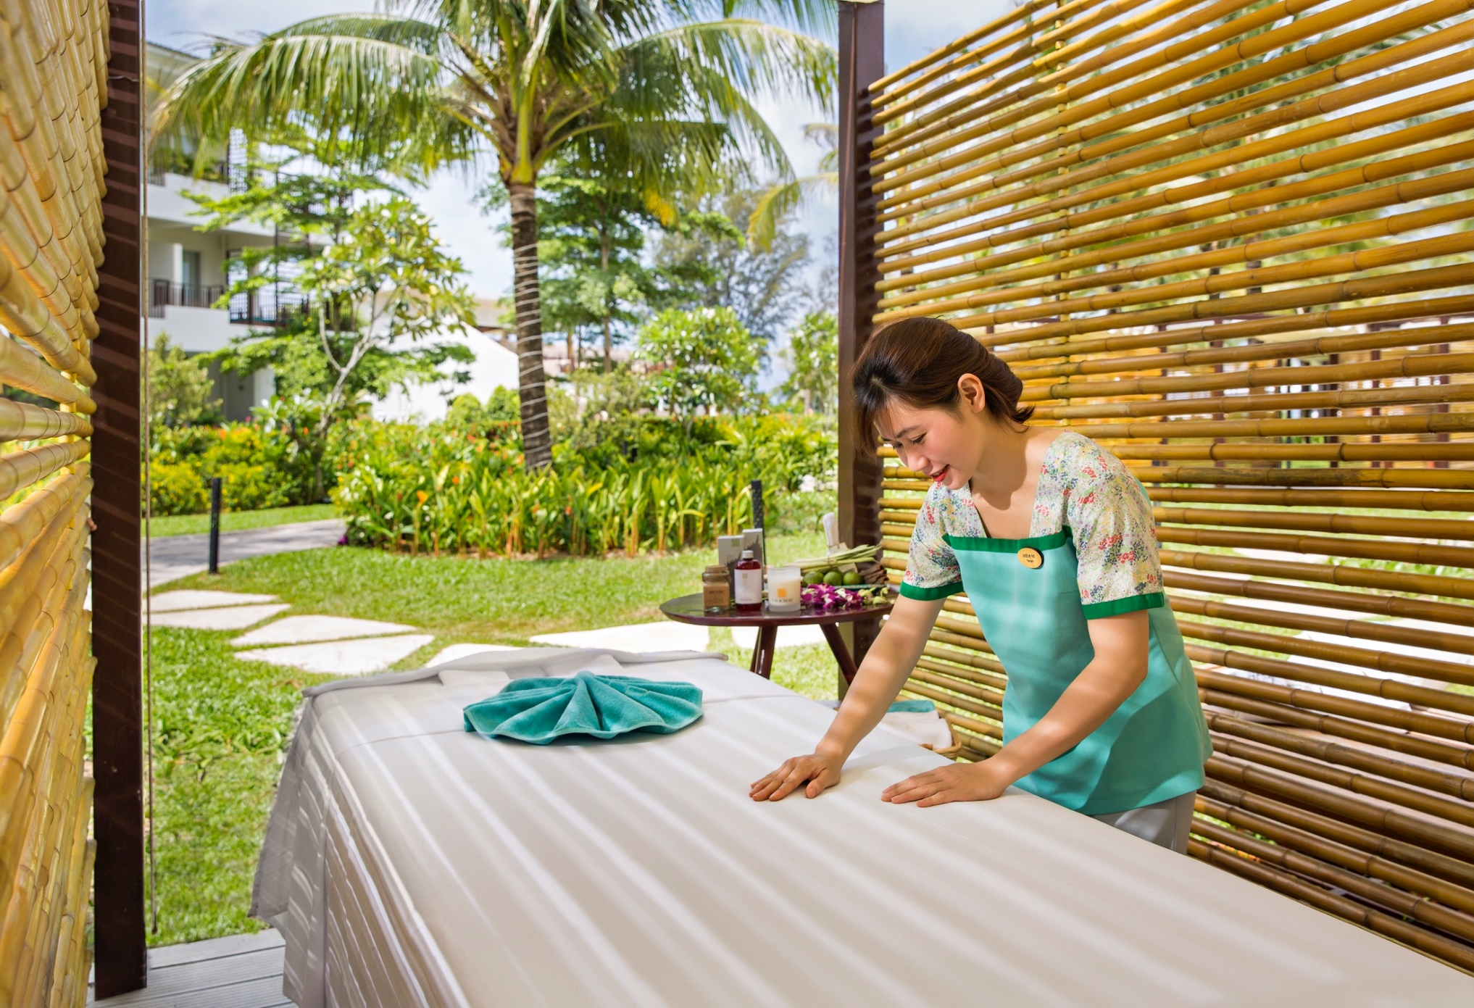
BODY & SOL SPA
Tailor made detox programmer
A selection of purifying juices &
private Yoga classes
Selection of holistic treatments,
massages, and meditation sessions.
Location: Main Building
Operation time: 10.00AM to 9.00PM

Slide 17

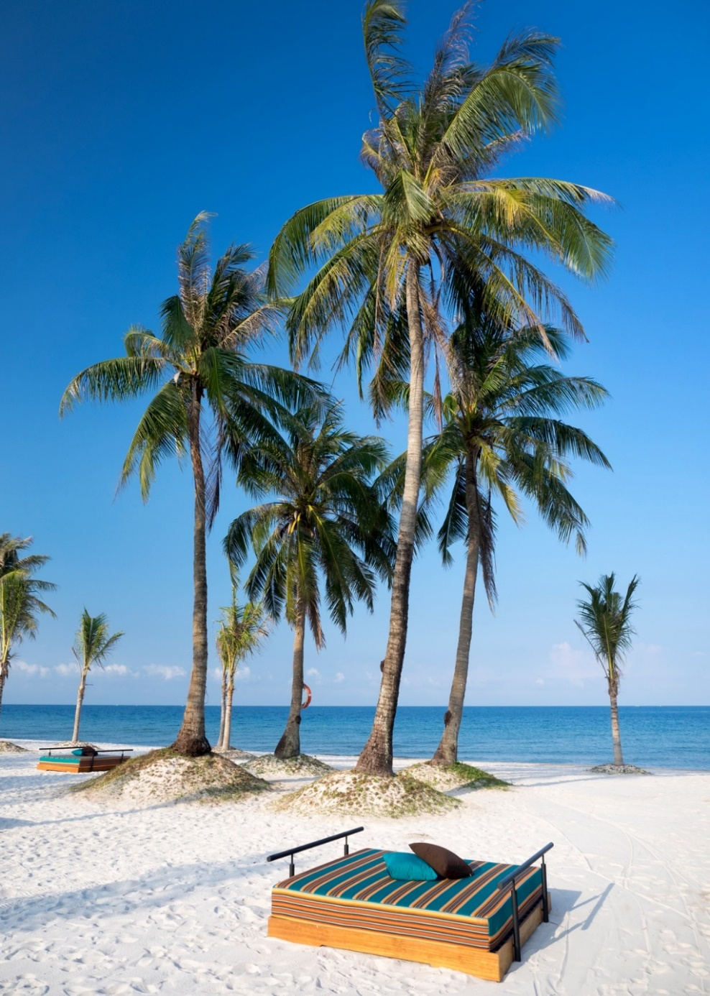
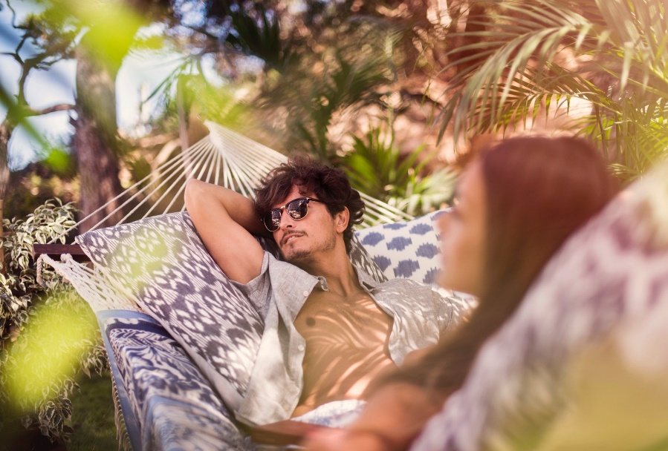
GUEST EXPERIENCES
WHITE SANDY BEACH
SEDUCE BEACH EXPERIENCES

Slide 18

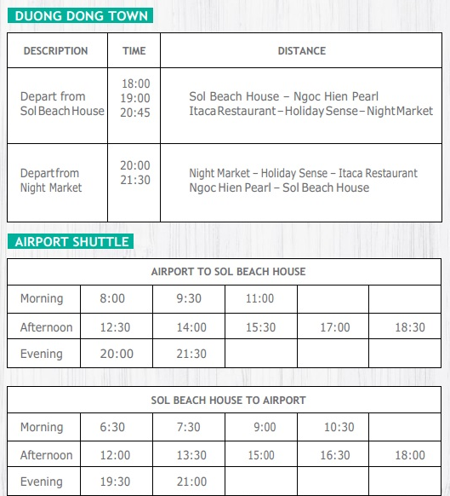
ACTIVITIES
SHUTTLE BUS
YOGA
TAI CHI
STRETCHING
SWIMMING CLASS
AQUA FITNESS
BEACH VOLLEY
PING PONG
SUNSET YOGA

Slide 19
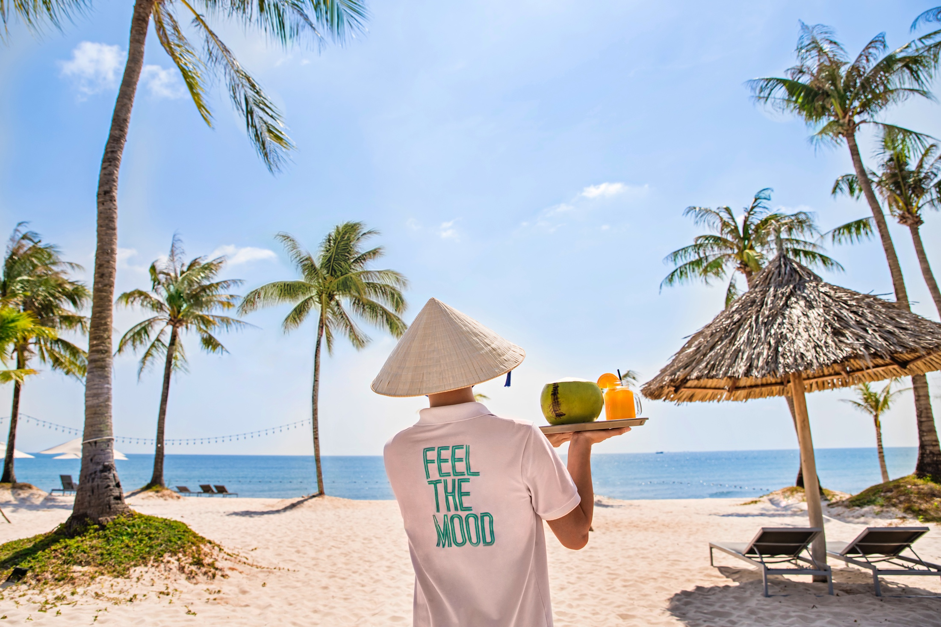
SOL BEACH HOUSE PHU QUOC
Zone 1, Duc Viet Tourist Area, Bai Truong Complex, Duong To Commune,
PHU QUOC Island, KIEN GIANG Province,
T. +84 297 386 9999
F. +84 297 378 1111
E. reservations@solbeachhousephuquoc.net

